Slide 1
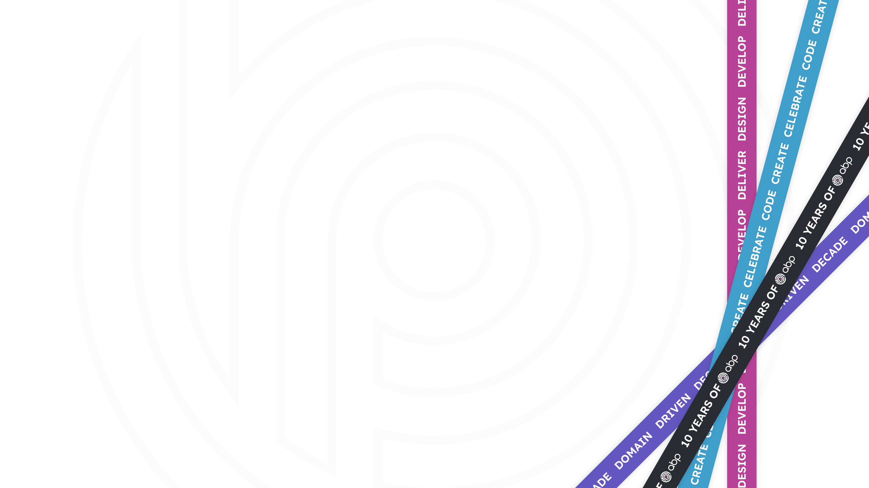



ABP Community News &
.NET 8 Release
Alper Ebiçoğlu
ABP Core Team Member
twitter.com/alperebicoglu

Slide 2
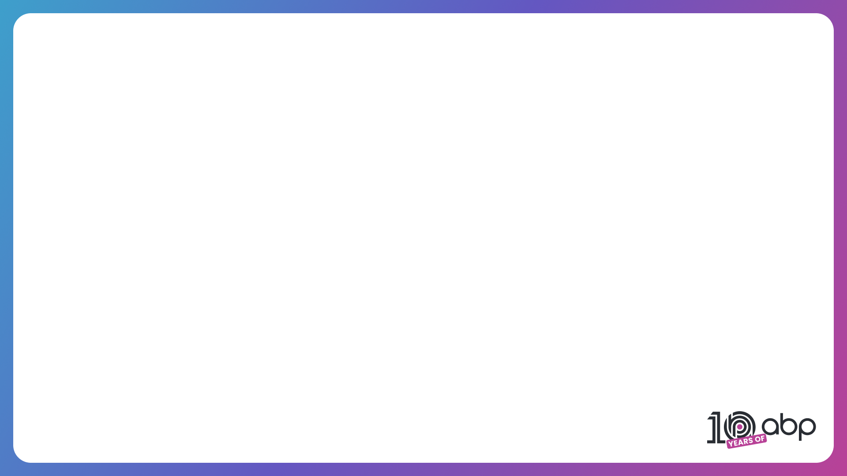
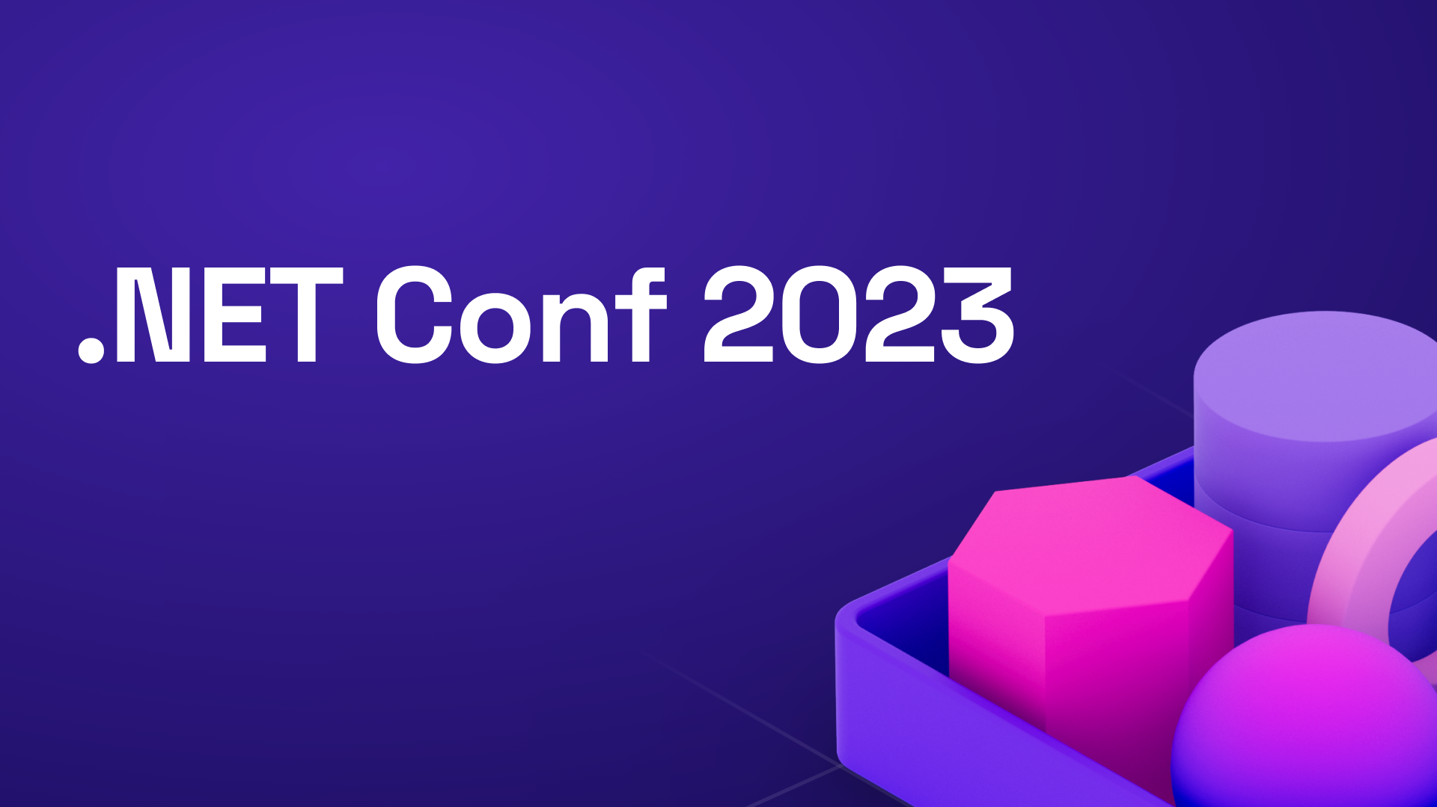
Celebrated the release of .NET 8
Held on November, 14 - 16
Notes:
As you know, last week there was .NET Conf 23.
The biggest .NET related virtual event!
This event has been an annual tradition for the past 12 years
This year’s theme was .NET 8 release.

Slide 3
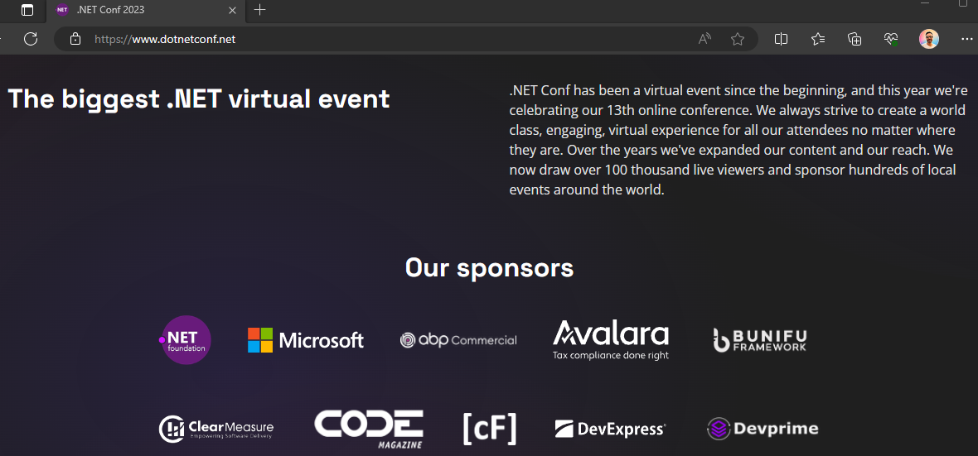
Proud to be sponsoring .NET Conf 23
Notes:
We support open-source platforms, .NET related events by sponsoring or talking in these organizations.
We were one of the sponsors of this virtual event.

Slide 4
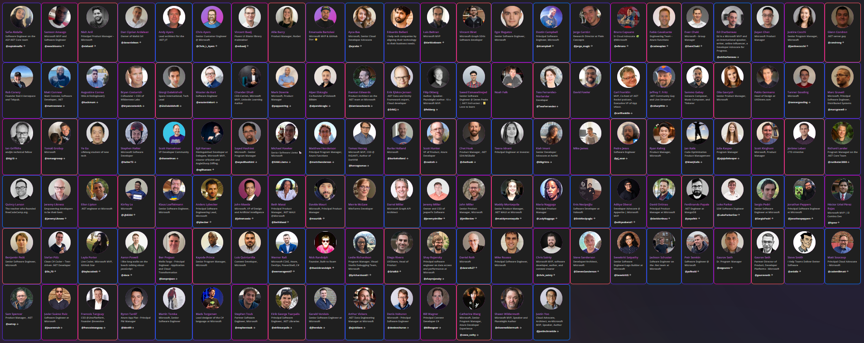
.NET Conf 23 — Speakers
Notes:
It was a great event with three-days non-stop broadcast.
There were 130 speakers and almost 100 sessions
Speakers talked about the new features of .NET 8, C# 12, Azure, Visual Studio
Also mobile, cloud, desktop development, gaming, IoT, trending topic AI.
There were live Q&A sections, games, prizes and digital swags
Famous names from the NET Team, such as Scott Hanselman, Damian Edwards, David Fowler, Steve Sanderson participated in this event.
And also me and Enis from ABP team were also speakers.

Slide 5
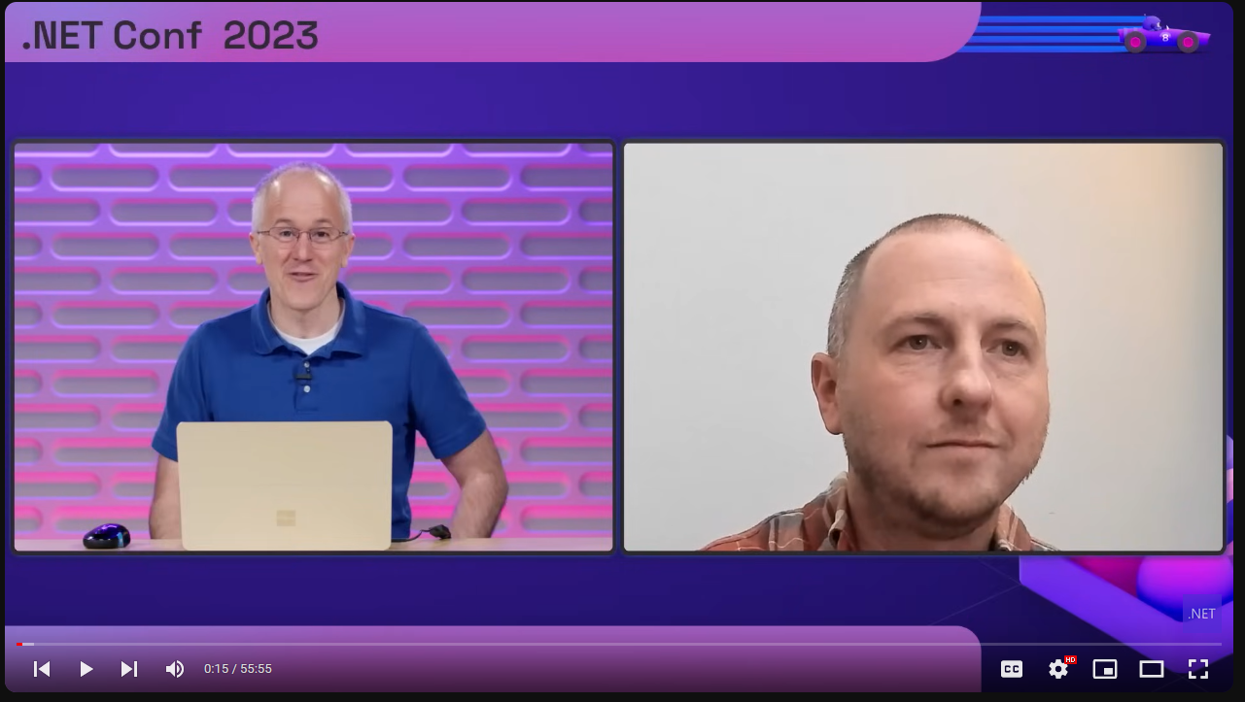
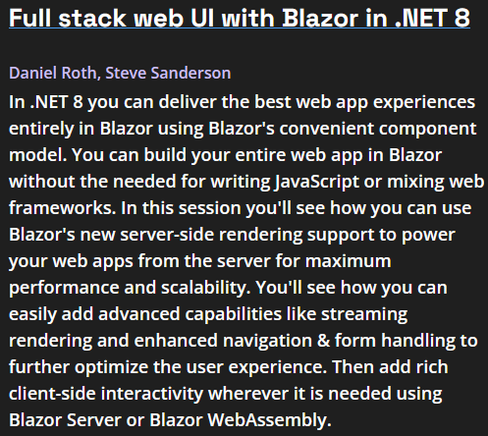
.NET Conf 23 — Highlights
Notes:
The first day of .NET Conf 2023 focused on the announcements and features of .NET 8.
Steve and Daniel talked about Blazor Full Stack UI (formerly known as Blazor United)
This new approach combines the advantages of Blazor-Server and Blazor WASM.
I also wrote a post about Blazor’s different versions and and the new Full-stack Web UI
https://community.abp.io/posts/blazors-history-and-fullstack-web-ui-gvk8vwqr

Slide 6
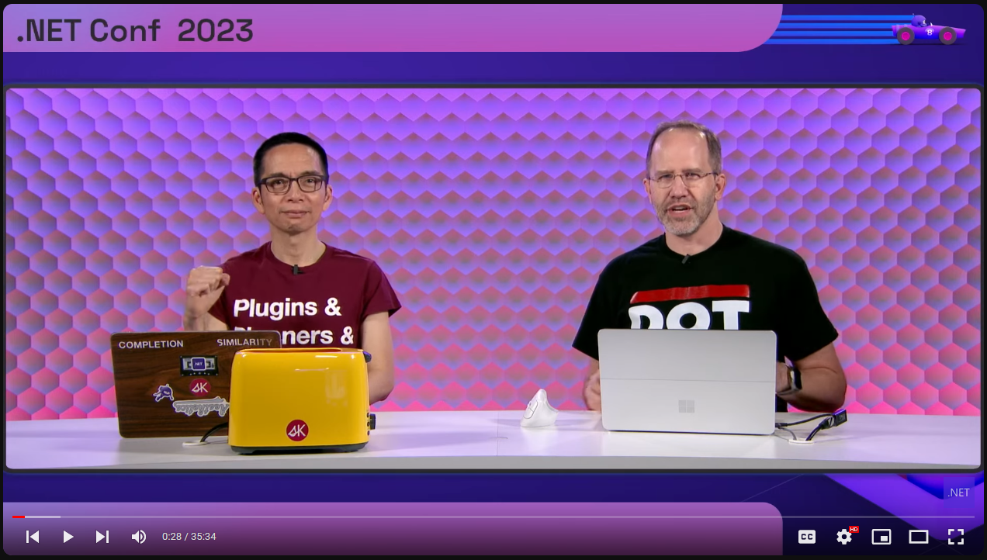
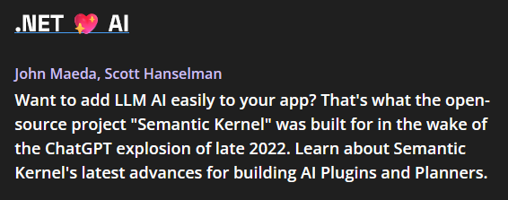
.NET Conf 23 — Highlights
Notes:
AI is trending nowadays and Scott Hanselman talk was about Semantic Kernel for creating AI Plug-ins and Planners.

Slide 7
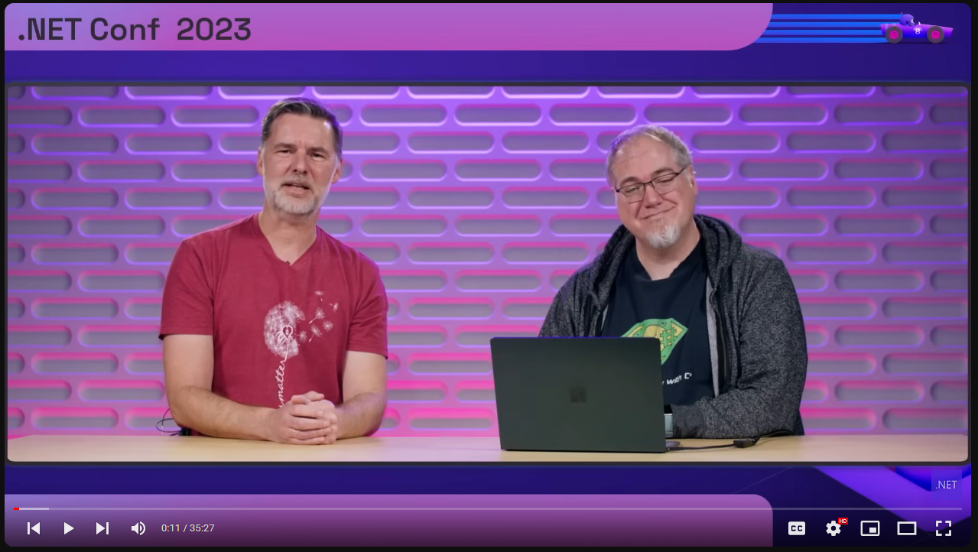
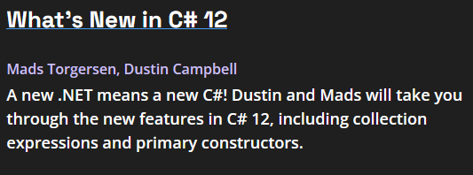
.NET Conf 23 — Highlights
Notes:
Mads Torgersen talked about the new features in C#12 like primary constructors, collection expressions, inline arrays and interceptors.

Slide 8
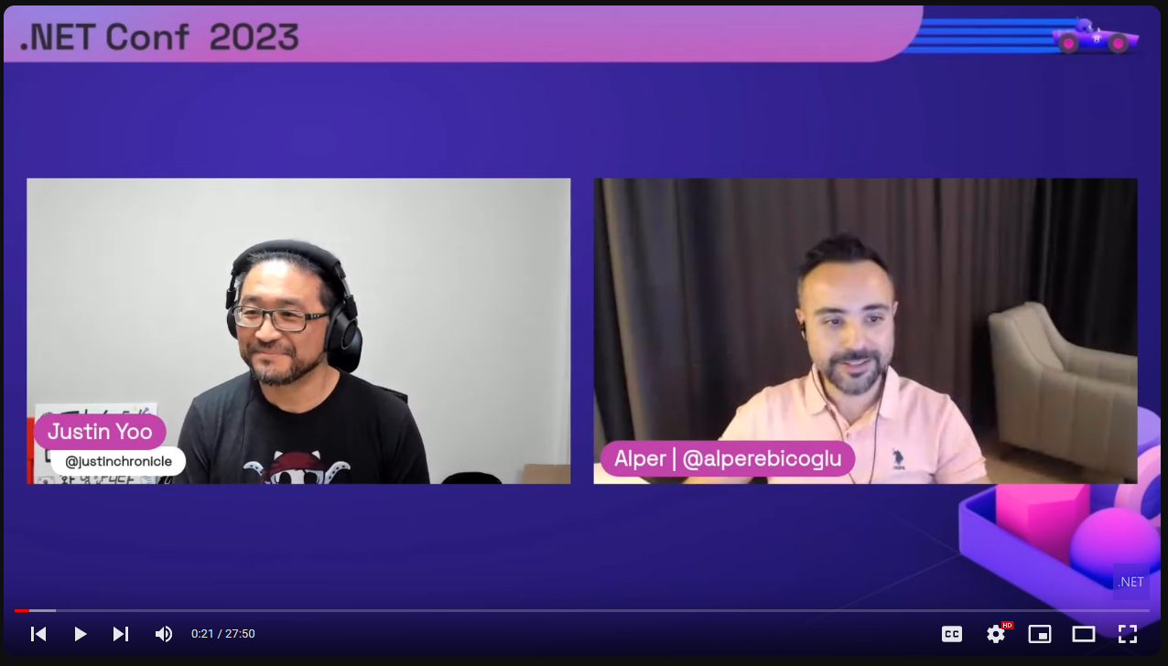
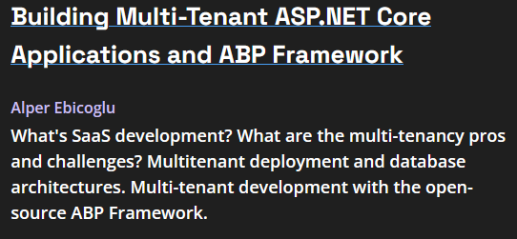
.NET Conf 23 — Highlights
Notes:
My talk was about telling my experiences on multi-tenancy that I gained when building ABP - multi-tenant web application framework.

Slide 9
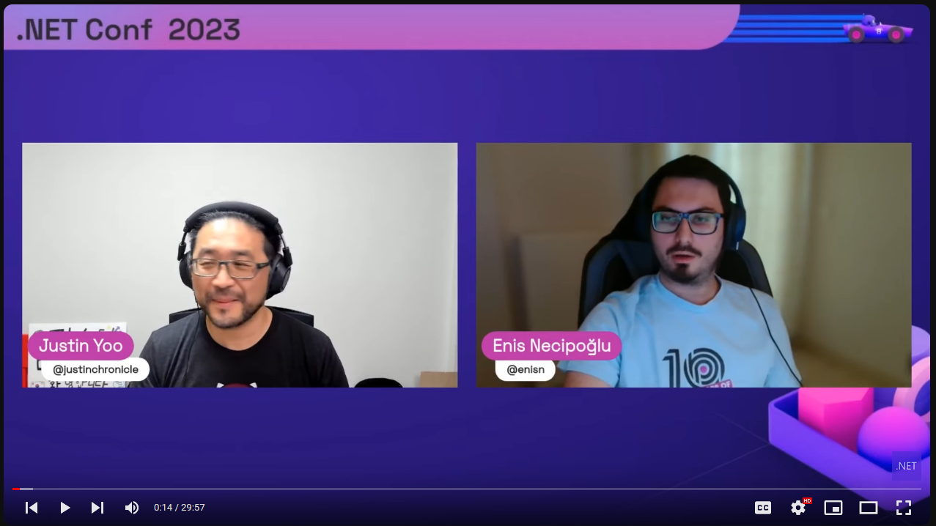
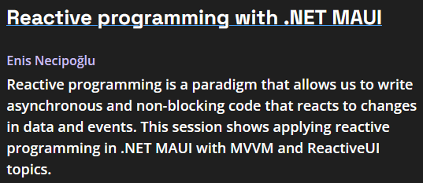
.NET Conf 23 — Highlights
Notes:
And Enis from our team talked about Reactive programming with .NET MAUI.

Slide 10
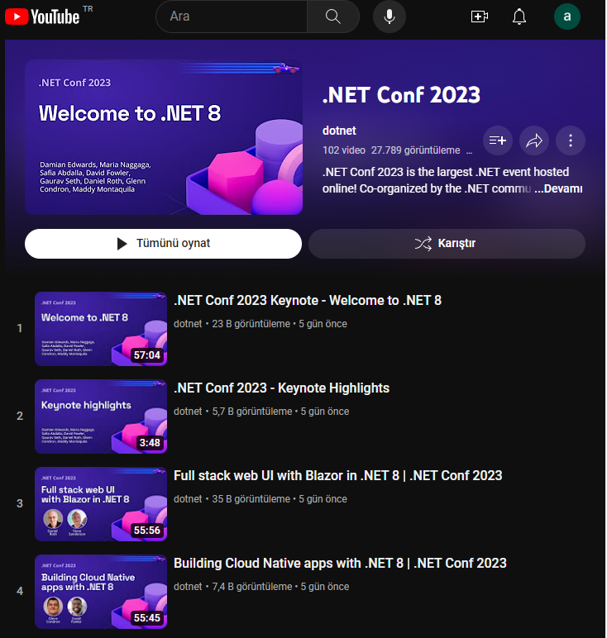
.NET Conf 23 — Highlights
All sessions are now posted to YouTube
Over 100 videos with 50 hours of content!
https://www.youtube.com/playlist?list=PLdo4fOcmZ0oULyHSPBx-tQzePOYlhvrAU
Notes:
And all sessions are now posted to YouTube - over 100 videos with 50 hours of content

Slide 11
Community News
ASP.NET Core 8
What’s New in .NET 8? — Alper Ebiçoğlu
Blazor's History and Full-stack Web UI — Alper Ebiçoğlu
New Minimal APIs features in ASP.NET Core 8 — liangshiwei
ASP.NET 8: What's New About Authentication and Authorization — Berkan Şaşmaz
.NET 8: Serialization Improvements — İsmail Çağdaş
ASP.NET Core Metrics with .NET 8 — Engincan Veske
Native AOT Compilation in .NET 8 — Enis Necipoğlu
Changes with Containers in NET 8 — Liming Ma
Entity Framework 8
Using Complex Types as Value Objects with Entity Framework Core 8.0 — Halil İbrahim Kalkan
EF Core 8 Primitive collections — Ahmet Faruk Ulu
EF Core 8 - Enhancements to JSON column mapping — Salih Özkara
HierarchyId Support in Entity Framework Core — Muhammet Ali Özkaya
New Raw SQL queries for unmapped types with EF Core 8.0 — Liming Ma
Read at https://volosoft.com/blog/Highlights-for-ASP-NET-Entity-Framework-Core-NET-8-0
Notes:
ABP is built on top of . NET, that’s why we are closely following the new releases and improvements in .NET
And with the new .NET release, all our team members picked a topic and write a blog post about the new features of ASP.NET Core and EF Core 8.
And this way we’re trying to help expanding the .NET Community…
The articles are about the new minimal APIs, ASP.NET Core’s authentication and authorization features. .NET 8 serialization improvements, ASP.NET Core metrics, .NET 8 native AOT compilation and so on…

Slide 12
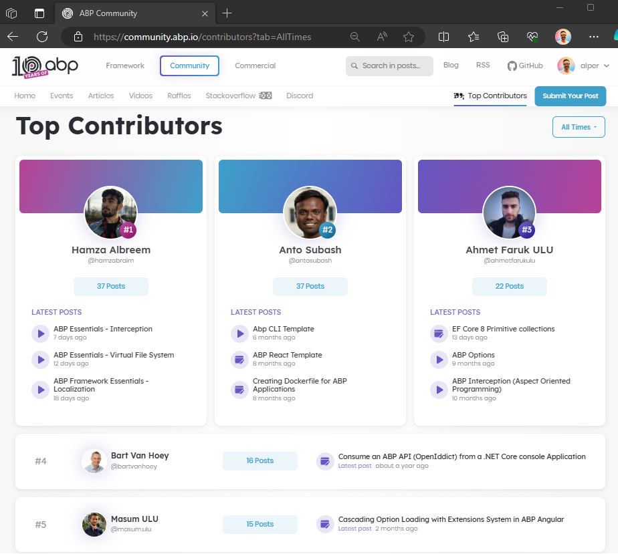
Community News
Top Contributors of
ABP Community
We highlight community members who write articles and record video tutorials.
https://community.abp.io/contributors
Notes:
Community.abp.io is a hub for ABP Framework, .NET and software development stuff.
You can read the articles, watch the video tutorials,
We created a new page to highlight our members who contributes to the community.abp.io website by writing articles and recording video tutorials.
It’s a good way to encourage other community members' contributions.

Slide 13
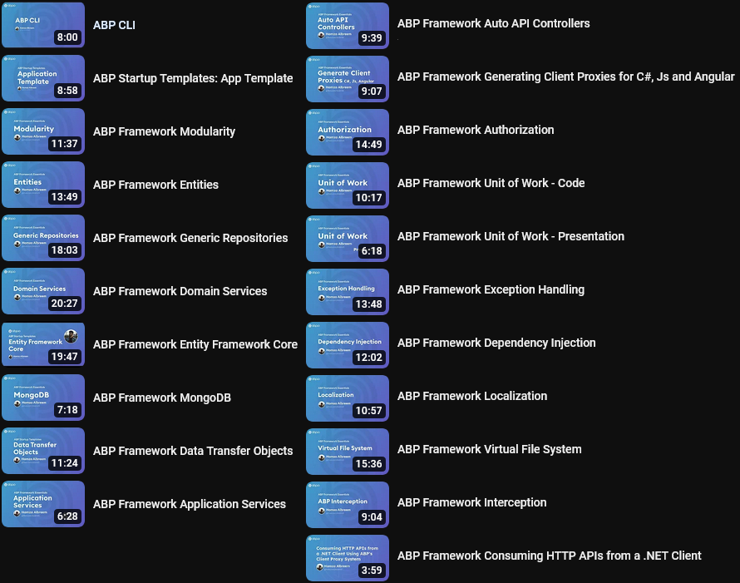
ABP
ESSENTIALS
VIDEO
TUTORIALS
https://community.abp.io/videos
Notes:
If you have just started ABP, I have good news for you.
We have been working on these video tutorials for the last 1 year for the new ABP users to easily understand the basics of this framework.
There are already 21 videos that explains the fundamental concepts for building ABP web applications.

Slide 14
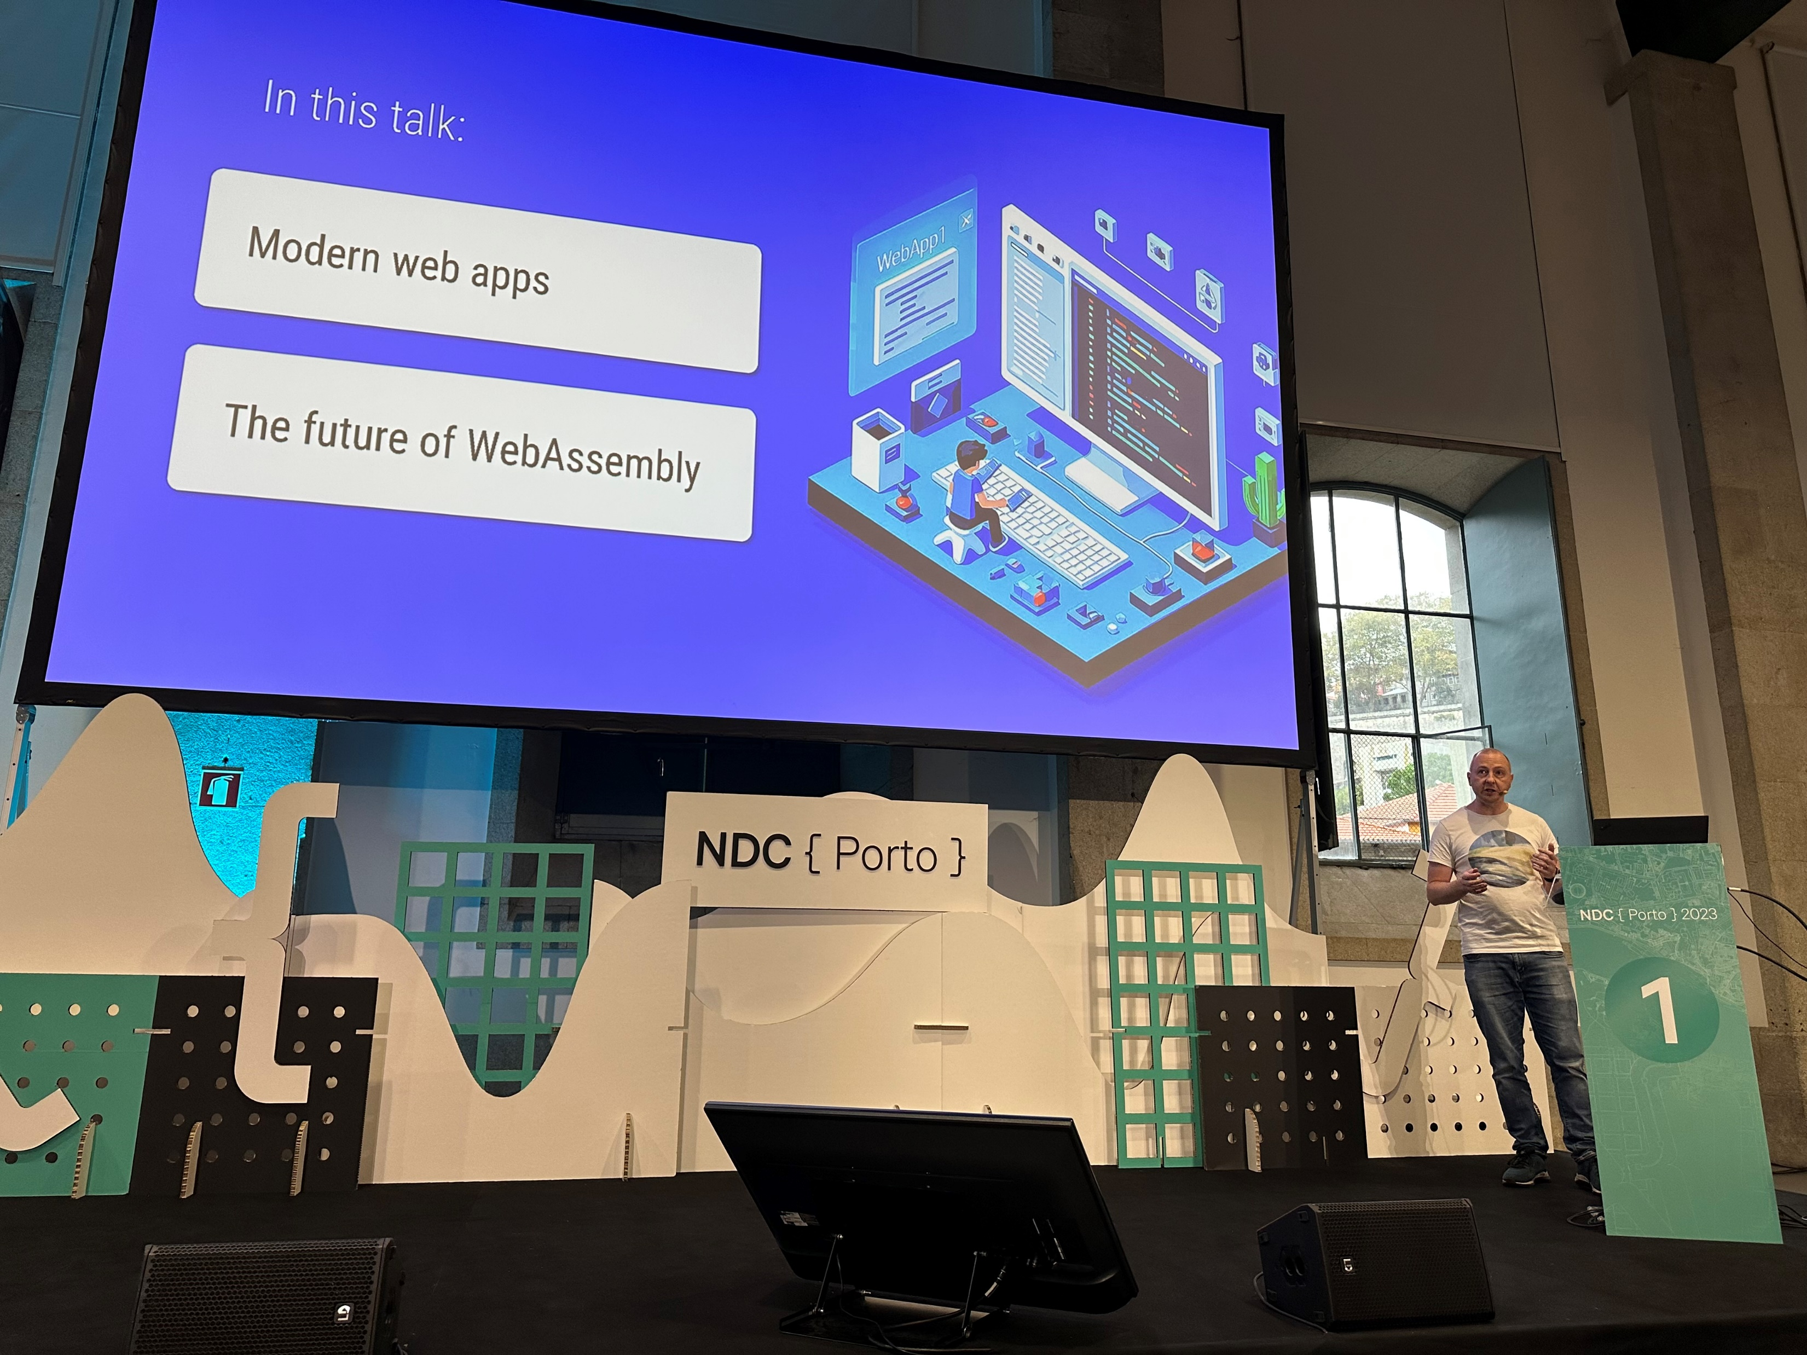
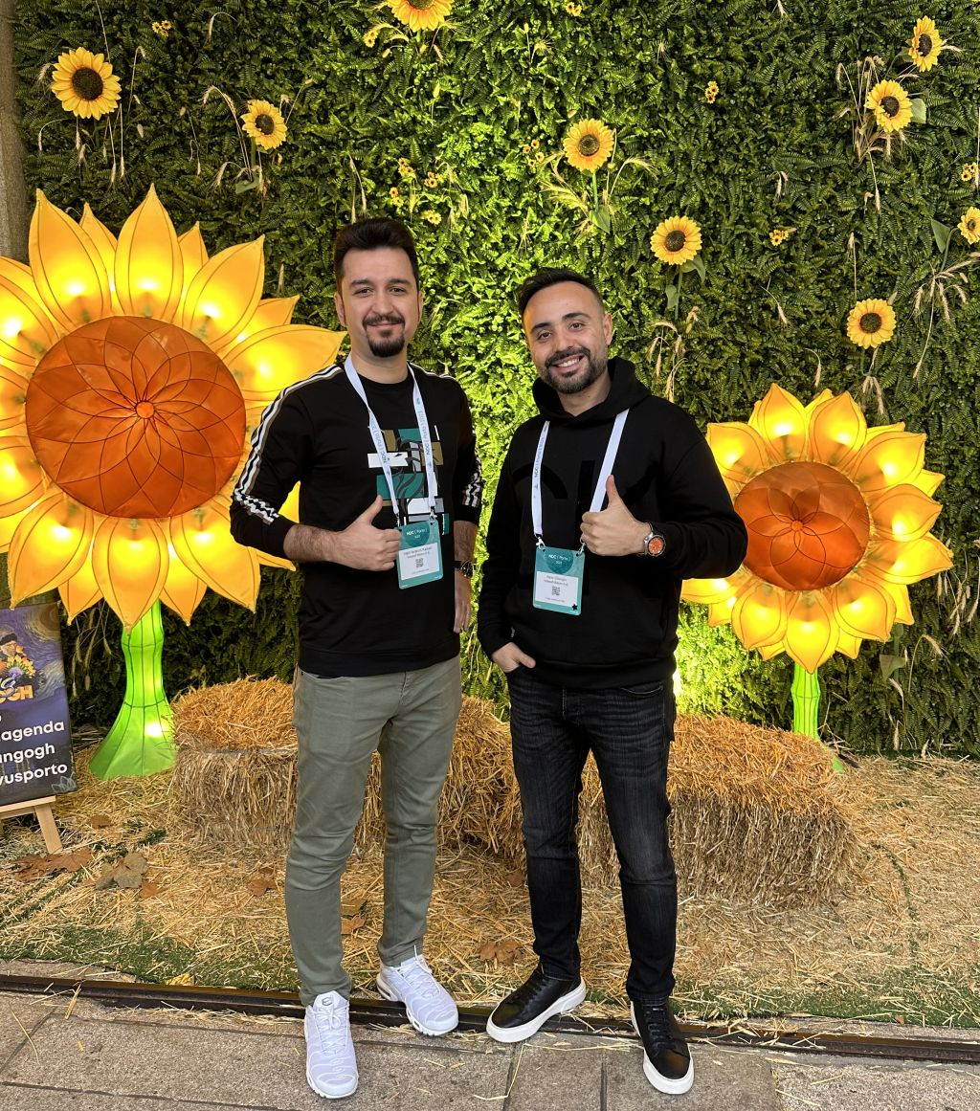
NDC Porto 2023 Impressions
Read at https://volosoft.com/blog/ndc-port-2023-impressions
Notes:
As the ABP team, we always read, research and regularly attend conferences to learn the latest updates about .NET and other development stuffs.
Last month we attended 2 conferences.
First one NDC Porto conference.
It was a 5-day event. 2 days were workshops, and 3 days were conference days with parallel sessions. There were 95 speakers and over 100 sessions.
Mainly the talks were about .NET , AI, Cloud, Cross-platform programming.
And I attended Steve’s session. The topic was “Where Web Tech is Going Now”.
Steve showed some live code examples in Next.js , SvelteKit, Blazor, Astro. To show how these are applying a similar approaches for the new web standards… and he showed how to implement these features without the need for a framework. And finally he talked about the new Blazor WASI.

Slide 15
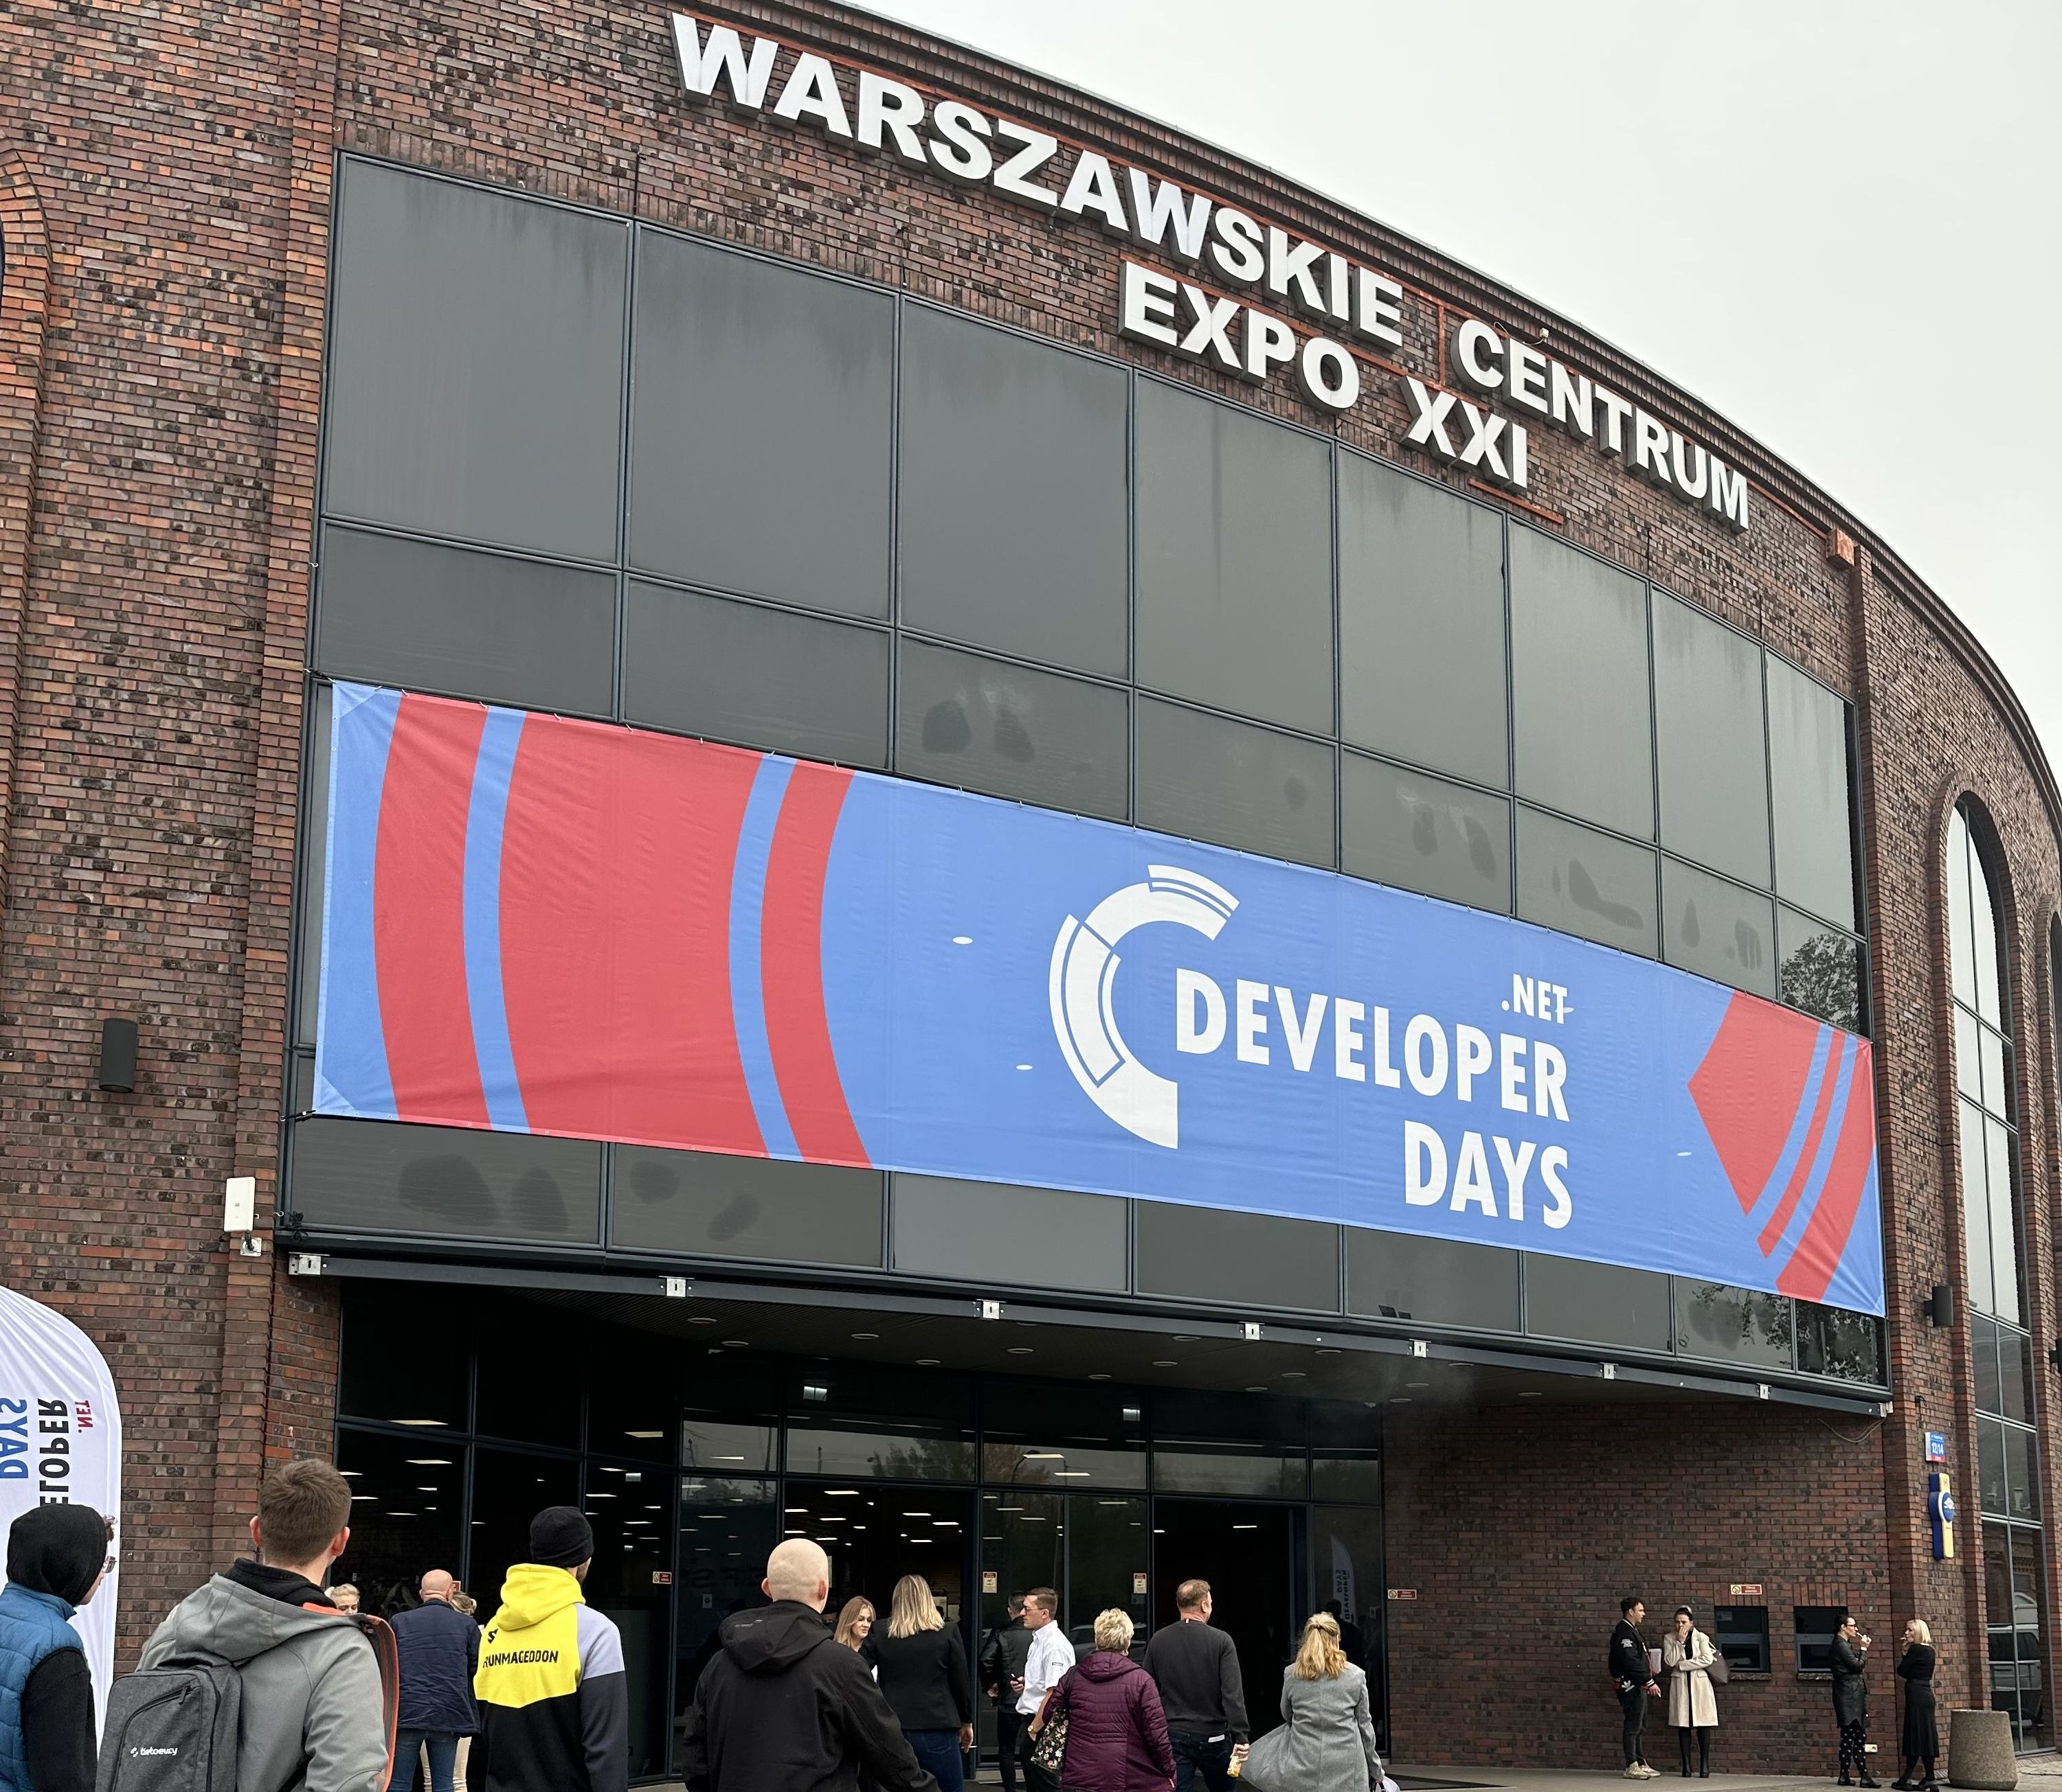
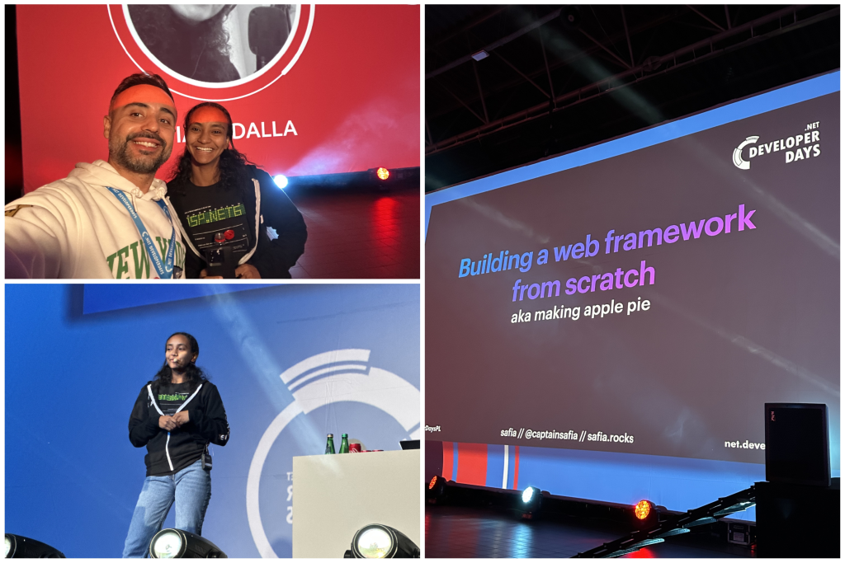
.NET Developer Days 2023 Impressions
Read at https://volosoft.com/blog/net-developer-days-2023-impressions
Notes:
Then we went to .NET Developer Days in Warsaw Poland.
The place was really huge. This is the first time I've been to such a big conference.
Over 800 visitors physically attended! This is a very good number for a pure .NET conference.
More than 30 talks were executed with 20 great speakers.
As it's a .NET developer conference, there were some dear Microsoft employees focusing on the new upcoming version .NET 8, like Scott Hunter, April Edwards, Safia Abdallah, Mads Torgersen and Stephen Toub.

Slide 16
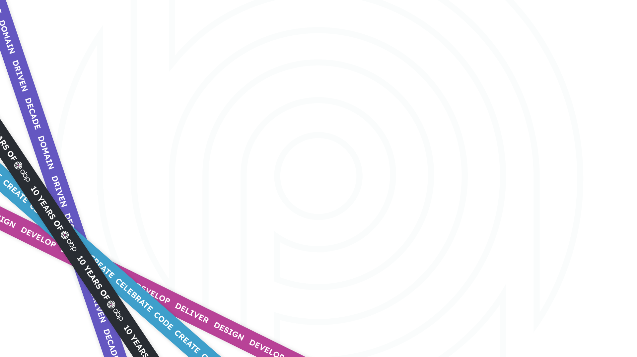



That’s all from me ☺
https://twitter.com/alperebicoglu
https://github.com/ebicoglu
https://medium.com/@alperonline

